Slide 1
Ion Channels are Biological Devices
Bob Eisenberg
IIT and Rush University
Chicago
October 18, 2019

Slide 2


Center for
Enhanced Nanofluidic Transport
Hello to old friends in the audience!!!
Thanks to Prof. Strano
For the invitation
and to Sam Faucher for showing me how to use Webex

Slide 3
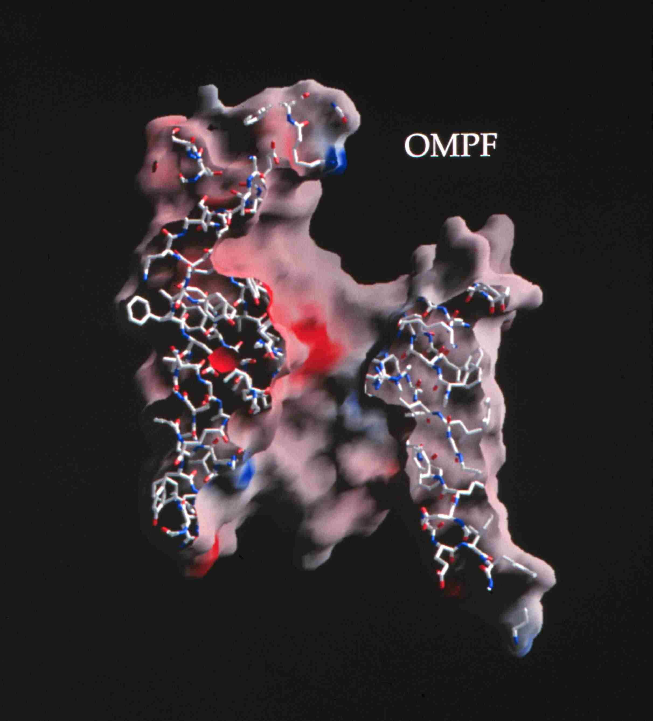
Natural nano-valves for atomic control of biological function
Ion Channels are Biological Devices
Bob Eisenberg
October 2019
Ion channels coordinate contraction of cardiac muscle, allowing the heart to function as a pump
Ion channels coordinate contraction in skeletal muscle
Ion channels control all electrical activity in cells Ion channels produce signals of the nervous system
Ion channels are involved in secretion and absorption in all cells: kidney, intestine, liver, adrenal glands, etc.
Ion channels are involved in thousands of diseases and many drugs act on channels
Ion channels are proteins whose genes (blueprints) can be manipulated by molecular genetics
Ion channels have structures shown by x-ray crystallography in favorable cases
K⁺
~30 Å
Figure of ompF porin by Raimund Dutzler
Notes:
Ion channels are a class of Proteins that reside in the cell membrane of all biological cells. Each channel protein consists of a chain of amino acids folded in such a way that it forms a nanoscopic water-filled tunnel through which ions can flow to cross the otherwise impermeable membrane.
Every ion channel carries a strong and steeply varying distribution of permanent charge, which depends on the particular combination of channel and prevalent physiological conditions. This permanent charge has an important role in determining the current-voltage characteristics of the open channel.
Many channels are designed by nature to selectively transmit or block a particular ion species. This allows only one type of ion to cross the membrane even though other ions may be present in much higher concentrations. Many channels can also open and close by mechanical or other means, switching on and off like electronic devices.
From a physiological point of view ion channels are essential for maintaining the correct internal ion composition necessary for cell survival and function. They directly control electrical signaling in the nervous system, muscle contraction, and the delivery of many clinical drugs. Malfunctioning channels cause or are associated with many diseases.
From a device point of view, ion channels can be thought of as elements in an electrical circuit, behaving like resistors, diodes or batteries depending on the specific channel and environmental factors. By replacing or deleting one or more of the amino acids many channels can be mutated, altering the charge distribution along the channel. Designing and engineering channels with specific conductances and selectivities, and incorporating them into bio-devices, is a real possibility.

Slide 4
Channels are Devices Valves and Diodes Different Ions Carry Different Signals through Different Channels
ompF porin
Devices have INPUTS
OUTPUTS
connected by LAWS
involving FLOW
from POWER SUPPLIES
so analysis of Devices
must be
NONEQUILIBRIUM with spatially
non-uniform BOUNDARY CONDITIONS
Thermodynamics, Statistical Mechanics, Molecular Dynamics have
No inputs, outputs, flows, or power supplies Power supply=spatially nonuniform inhomogeneous Dirichlet conditions
+
0.7 × 10⁻⁹ meter = Channel Diameter
~3 x 10⁻⁹ meters
Flow time scale is 10⁻⁴ sec to 1 min
Figure of ompF porin by Raimund Dutzler

Slide 5
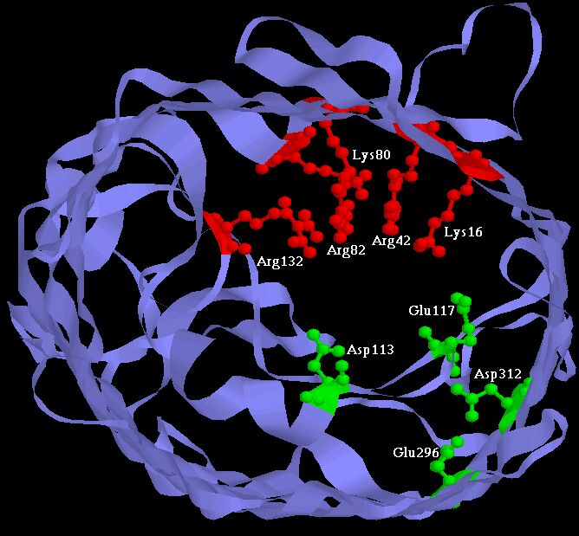

Slide 6
Bob Eisenberg DARPA

Slide 7
Bob Eisenberg DARPA

Slide 8
Active Sites of Proteins are Very Charged
e.g. 7-9 charges ~ 20 M net charge = 1.2×10²² cm⁻³
Selectivity Filters and Gates are
Active Sites of Ion Channels
Aspartate -1e Glutamate -1e
Lysine +1e
Permanent Charge
1 nM

Slide 9
Crowded Active Sites are 18.9 M acid and base groups in 573 enzymes assuming all are ionized fully
Enzyme Type |  | Catalytic Active Site Density (Molar) |  |  | Protein
 |  | Acid (positive) | Basic (negative) | | Total | | Elsewhere
 | Total (n = 573) | 10.6 | 8.3 | 18.9 | 2.8
EC1 | Oxidoreductases (n = 98) | 7.5 | 4.6 | 12.1 | 2.8
EC2 | Transferases (n = 126) | 9.5 | 7.2 | 16.6 | 3.1
EC3 | Hydrolases (n = 214) | 12.1 | 10.7 | 22.8 | 2.7
EC4 | Lyases (n = 72) | 11.2 | 7.3 | 18.5 | 2.8
EC5 | Isomerases (n = 43) | 12.6 | 9.5 | 22.1 | 2.9
EC6 | Ligases (n = 20) | 9.7 | 8.3 | 18.0 | 3.0
Jimenez-Morales, Liang, Eisenberg European Biophysics Journal 2012 41 449-460.

Slide 10
Synthetic Calcium Channels Designed by Theory
built by Henk Miedema, Wim Meijberg, George Robillard of BioMade Corp.,Groningen, Netherlands
Calcium selective
Unselective
Wild Type
As charge density increases, channel becomes calcium selective E_{rev} → E_{Ca}
Biophys J 2004 87(5): 3137-3147; Eur Biophys J 2006 36(1): 13-22.
Biophys J 2006 91(12): 4392-4400; Nano Lett. 2007 7(9): 2886-2891.
Biophys J 2006 90(4): 1202-1211.

Slide 11
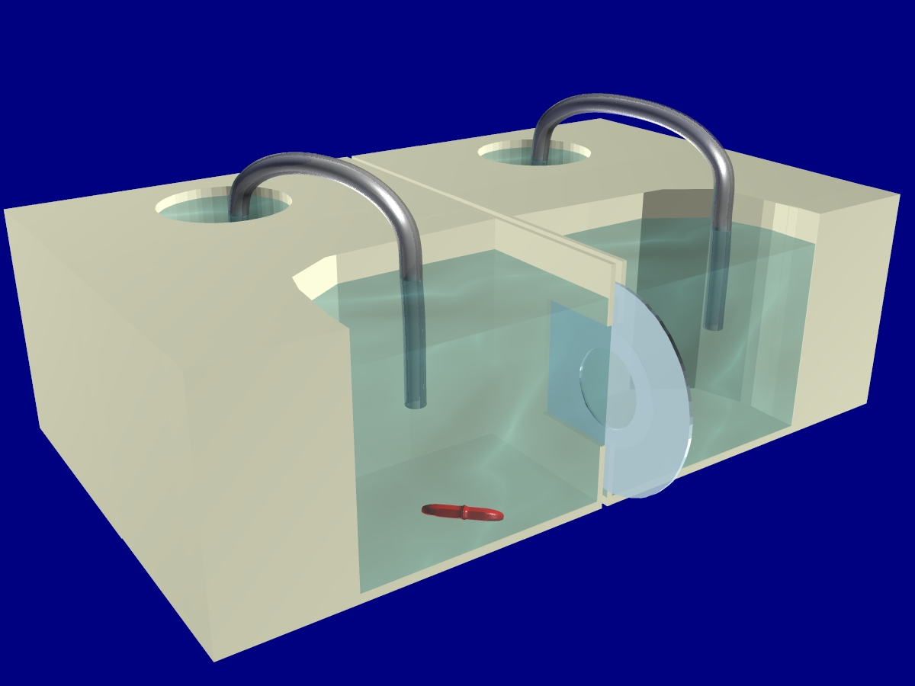
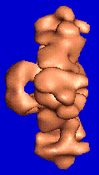
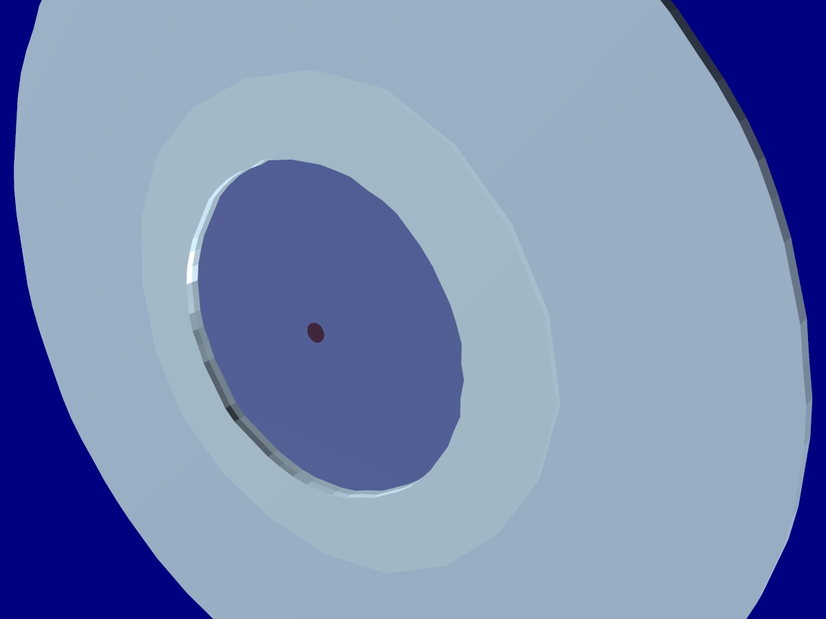
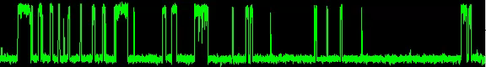
Single Calcium Channels
in Artificial Planar Lipid Bilayers
Conflict of Interest !
AxoPatch Clamp
Amplifier
Planar
Bilayer
Ca
Single L-type Ca Channel: Sample Trace
Experimental
Chamber
open
closed
Teflon
Septa
Thanks to Mike Fill !
80-100 µM
Diameter
Notes:
Movie is …. \Green Continuous0002.avi

Slide 12
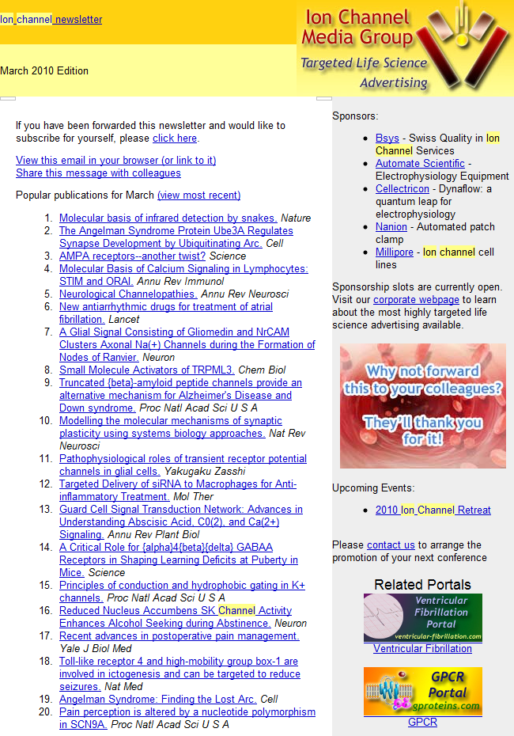
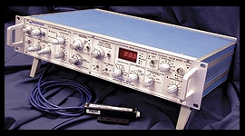
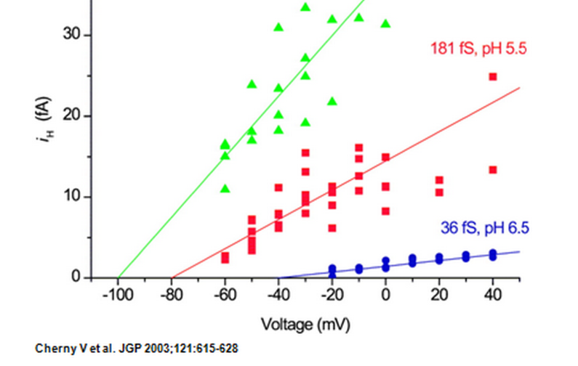
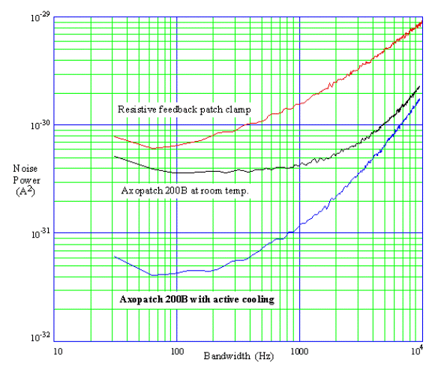
Thousands of Molecular Biologists Study Channels every day, One protein molecule at a time This number is not an exaggeration. We have sold >10,000 AxoPatch amplifiers
Ion Channel Monthly
AxoPatch 200B
Femto-amps
(10⁻¹⁵ A)

Slide 13
Channel Structure Does Not Change
once the channel is open
Current vs. time Time dependence is called ‘gating’
Amplitude vs. Duration Amplitude is Called Single or Open Channel Current
Open
Closed
Open Amplitude, pA
5 pA
100 ms
Open Duration /ms
Lowpass Filter = 1 kHz Sample Rate = 20 kHz
Typical Raw Single Channel Records
Ca²⁺ Release Channel of Inositol Trisphosphate Receptor: slide and data from Josefina Ramos-Franco. Thanks!

Slide 14
Valves Control Flow
Channels are Devices
Channels are (nano) valves
Classical Theory & Simulations NOT designed for valves or flow
Thermodynamics, Statistical Mechanics do not allow flow
Rate and Markov Models do not Conserve Current
I_{AB} is a unidirectional current,
into an absorbing boundary condition

Slide 15
Devices have INPUTS
OUTPUTS
connected by LAWS
involving FLOW
from POWER SUPPLIES
so
Analysis of Devices
must be
NONEQUILIBRIUM with spatially
non-uniform BOUNDARY CONDITIONS
Thermodynamics, Statistical Mechanics, Molecular Dynamics have
No inputs, outputs, flows, or power supplies i.e., Power Supply = spatially nonuniform inhomogeneous Dirichlet conditions

Slide 16
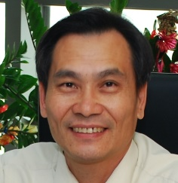
Poisson Fermi Approach to Ion Channels
Bob Eisenberg
Jinn-Liang Liu
劉晉良
¹PhysRev E (2006) 73:041512 ²PhysRev Ltrs (2011) 106:046102 ³JCompPhys (2013) 247:88 ⁴J PhysChem B (2013) 117:12051 ⁵Molecular Based Mathematical Biology 2017 5: 116-124, ⁶Physical Review E 2016 94(1): 012114

Slide 17
Motivation
Largest Effect of Crowded Charge is Saturation
Saturation cannot be described by classical Poisson Boltzmann approach

Slide 18
Motivation
Natural Description of Crowded Charge
is a
Fermi Distribution designed to describe saturation
Simulating saturation by interatomic repulsion is a significant mathematical challenge to be side-stepped if possible

Slide 19
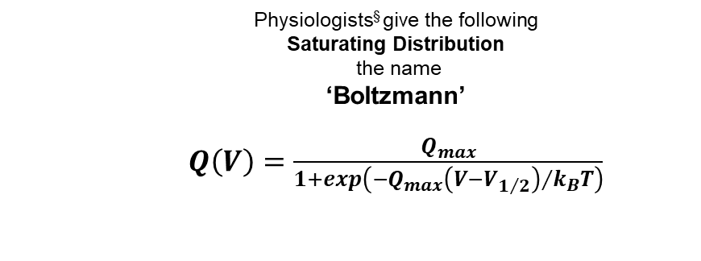
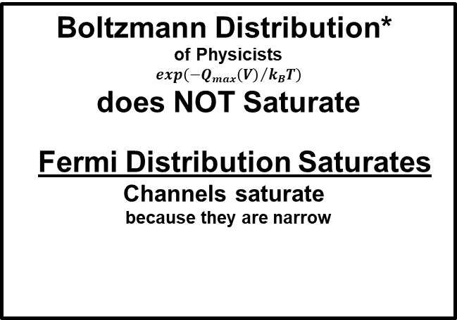
Interdisciplinary Confusion
Physiologists§ give the following Saturating Distribution the name
‘Boltzmann’
$Q\left(V\right)=\frac{Q_{max}}{1+exp\left({{−Q}_{max}\left(V−V_{1/2}\right)}/{k_{B}T}\right)}$
Interdisciplinary Confusion
Interdisciplinary Confusion
§ p.503 of Hodgkin and Huxley. 1952. J. Physiol. 117:500-544.
more recently
§ Bezanilla, Villalba-Galea J. Gen. Physiol (2013) 142: 575
Boltzmann Distribution*
of Physicists $$exp\left({{−Q}_{max}\left(V\right)}/{k_{B}T}\right)$$
does NOT Saturate
Fermi Distribution Saturates Channels saturate because they are narrow
* Boltzmann. Berkeley ‘Lectures on Gas Theory’, 1904 (!)

Slide 20
Motivation
Fermi Description
is designed to deal with
Saturation of Concentration
without computing forces motivated by the Pauli Exclusion Principle
that avoids the calculation of inter-electron forces and correlations!

Slide 21
Fermi Description of Saturation of Volume by Spherical Ions
Fermi (like) Distribution
J.-L. Liu J Comp Phys (2013) 247:88

Slide 22
Poisson Fermi Formulation
We couple the Screened Coulomb (Yukawa) Potential*
and
Far Field Poisson Electrostatics
*to avoid the Lennard Jones Combining Rules that are Badly defined in Experiments and Simulations of Liquids

Slide 23
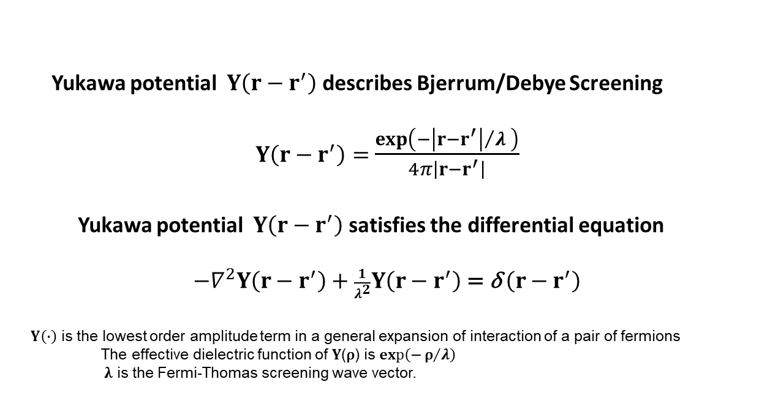
Yukawa Screened Coulomb Potential
Yukawa potential $Y\left(r−r^{′}\right)$describes Bjerrum/Debye Screening
$Y\left(r−r^{′}\right)=$ $\frac{\exp\left(−{\left|r−r^{′}\right|}/λ \right)}{4π\left|r−r^{′}\right|}$
Yukawa potential $Y\left(r−r^{′}\right)$ satisfies the differential equation
$−∇^{2}Y\left(r−r^{′}\right)+\frac{1}{λ^{2}}Y\left(r−r^{′}\right) \text{=} \text{δ} \left(r−r^{′}\right)$
$Y\left(∙\right)$ is the lowest order amplitude term in a general expansion of interaction of a pair of fermions The effective dielectric function of 𝐘(ρ) is $exp\left(−{\text{ρ}}/λ\right)⁡$
𝛌 is the Fermi-Thomas screening wave vector.
(1)
(2)

Slide 24
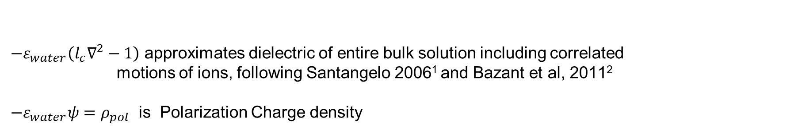
PNPF
Poisson-Nernst-Planck-Fermi
Implemented fully in 3D Code to accommodate 3D Protein Structures We introduce^{3,4} two second order equations and boundary conditions 2nd order equations make computation of 3D protiens feasible
${−ε}_{water}\left(l_{c}∇^{2}−1\right)$ approximates dielectric of entire bulk solution including correlated motions of ions, following Santangelo 2006¹ and Bazant et al, 2011²
${−ε}_{water}ψ=ρ_{pol}$ is Polarization Charge density
¹PhysRev E (2006) 73:041512 ²PhysRev Ltrs (2011) 106:046102 ³JCompPhys (2013) 247:88 ⁴J PhysChem B (2013) 117:12051

Slide 25
Poisson Fermi Analysis Status Report
Nonequilibrium implemented fully in 3D Code to accommodate 3D Protein Structures
But only partially compared to experiments in bulk or channels, so far.
Gramicidin (tested with real three dimensional structure, including flow) Physical Review E, 2015. 92:012711
Ca_{V}1.n EEEE, i.e., L-type Calcium Channel, tested with homology model
J Phys Chem B, 2013 117:12051 (nonequilibrium data is scarce)
PNPF Poisson-Nernst-Planck-Fermi for systems with volume saturation
General PDE, Cahn-Hilliard Type, Four Order, Pair of 2nd order PDE’s
Not yet tested by comparison to bulk data
J Chem Phys, 2014. 141:075102; J Chem Phys,141:22D532
Numerical Procedures tailored to PNPF have been implemented (tested) KcSA computed with K selectivity J Comp Phys, 2013 247:88; Phys Rev E, 2015. 92:012711
NCX Cardiac Ca²⁺/Na⁺ exchanger branched Y shape KNOWN structure.
First physical analysis of a transporter using consistent mathematics
Tested by comparison to superb physiological data, mostly complete
; .

Slide 26
More Detail
CHANNELS
and
Bulk Solutions

Slide 27
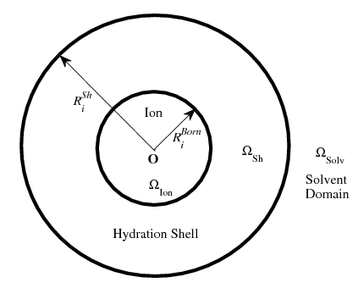
Poisson Fermi Approach to Bulk Solutions

Slide 28
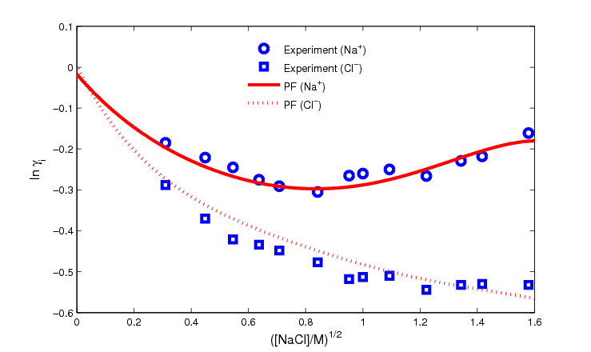
Activity Coefficients Na⁺ Cl⁻ ‘normalized’ free energy per mole

Slide 29
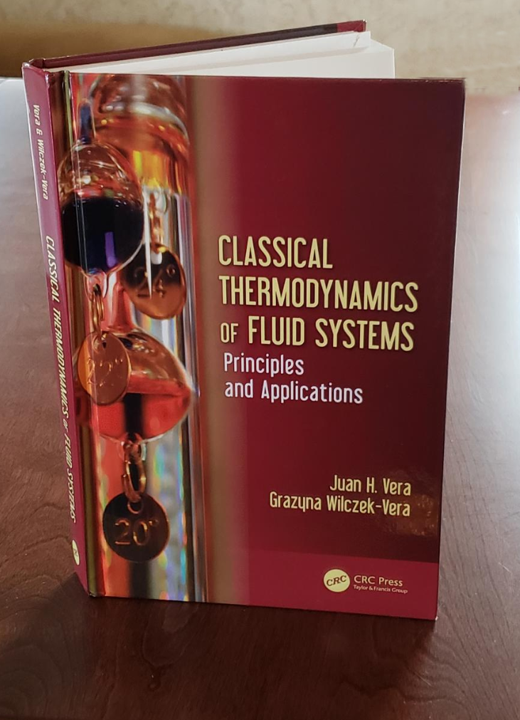
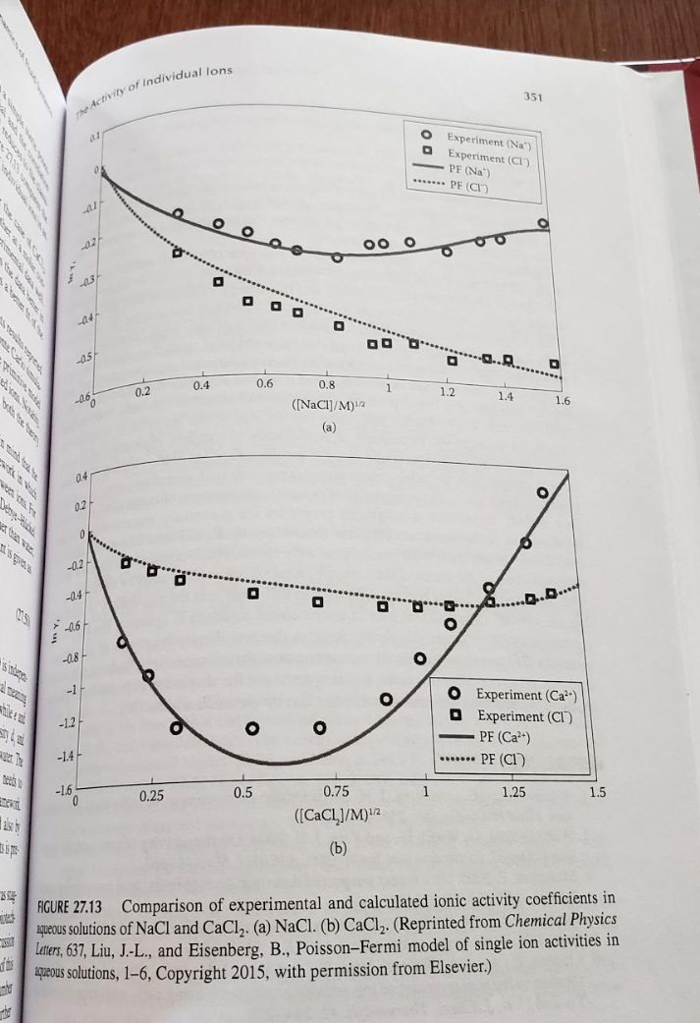
Activity Coefficients K⁺ Cl⁻

Slide 30
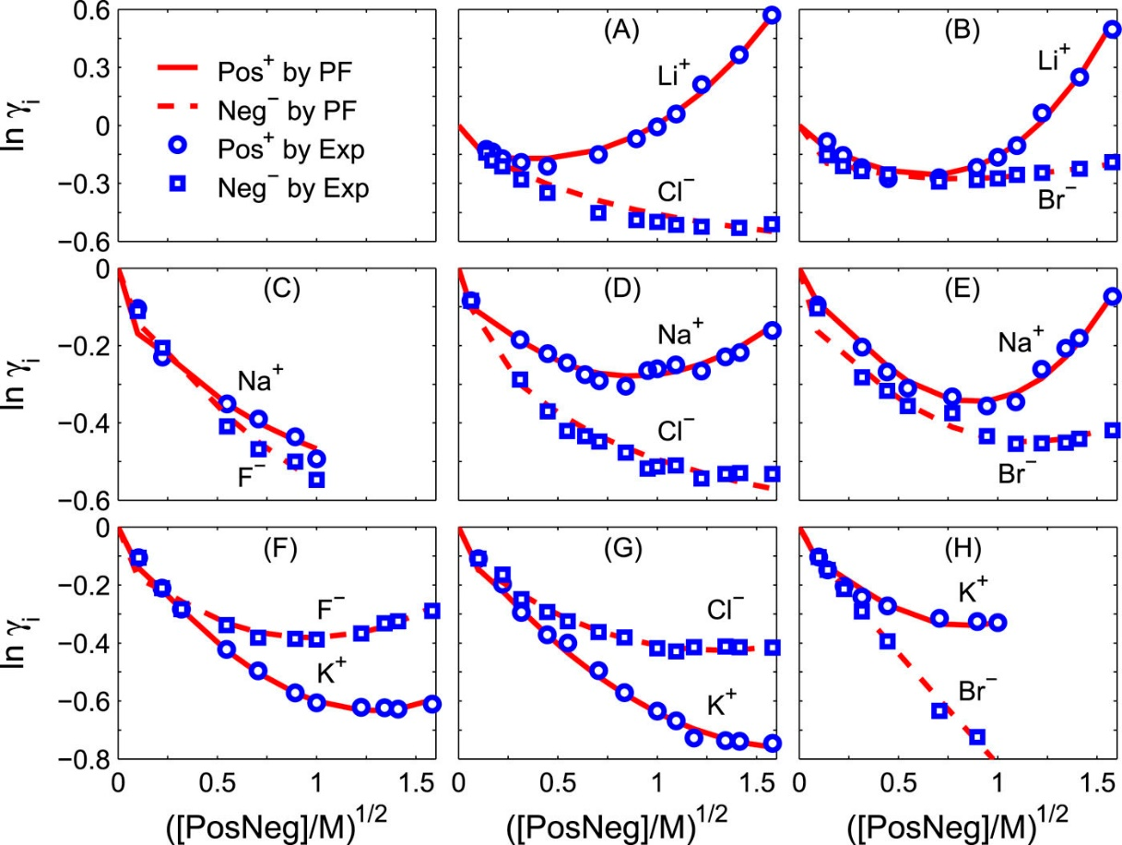
Activity Coefficients K⁺ Cl⁻ ‘normalized’ free energy per mole
Activity Coefficients K⁺ Cl⁻ ‘normalized’ free energy per mole
KCl
Individual activity coefficients of 1:1 electrolytes. Comparison of PF results with experimental data²⁶ _{on i = Pos}⁺ _{(cation) and Neg}⁻ (anion) activity coefficients in various [PosNeg] from 0 to 1.6M.
Published in: Jinn-Liang Liu; Bob Eisenberg; J. Chem. Phys. 148, 054501 (2018)
DOI: 10.1063/1.5021508
Copyright © 2018 Author(s)

Slide 31
Why are the fits so good?
Not sure,
Probably the composite Dielectric Function
joining atomic near field to electrodynamic far field
Stay tuned for new work

Slide 32
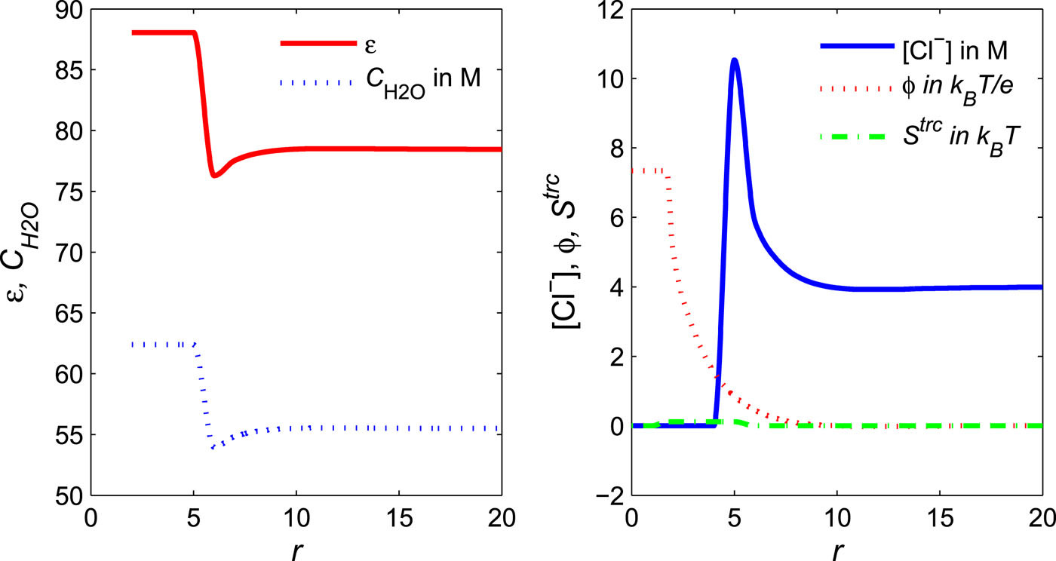
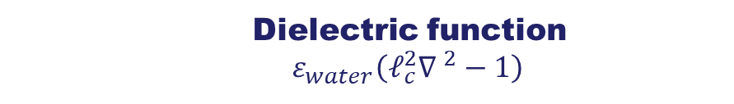
Dielectric function $ε_{water}\left(ℓ_{c}^{2}{∇ }^{2}−1\right)$
Dielectric function ϵ̃(r) (denoted by ε in the figure), water density CH2O(r) (CH2O), Cl⁻ _{concentration CCl−(r) ([Cl}⁻_{]), electric potential ϕ}^{PF}(r) (ϕ), and steric potential S^{trc}_{(r) (S}^{trc}) profiles near the solvated ion Ca²⁺ at [CaCl2] = 2M, where r is the distance from the center of Ca²⁺ _{in angstrom.}
Published in: Jinn-Liang Liu; Bob Eisenberg; J. Chem. Phys. 148, 054501 (2018)
DOI: 10.1063/1.5021508
Copyright © 2018 Author(s)

Slide 33
More Detail
CHANNELS

Slide 34
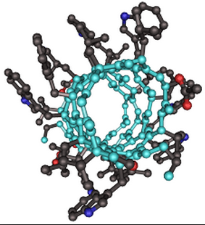
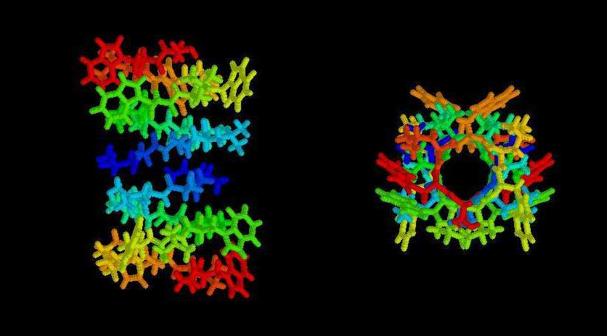
Gramicidin A
Unusual SMALL Bacterial Channel
often simulated and studied
Margaret Thatcher,
student of Nobelist Dorothy Hodgkin
Bonnie Wallace leading worker

Slide 35
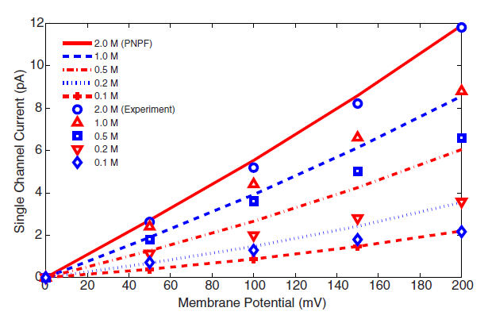
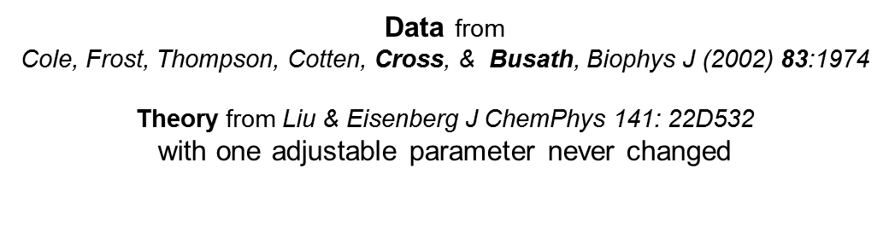
Three Dimensional Theory Comparison with Experiments
Gramicidin A

Slide 36
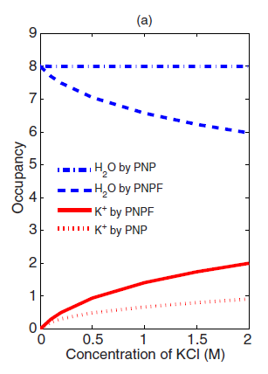
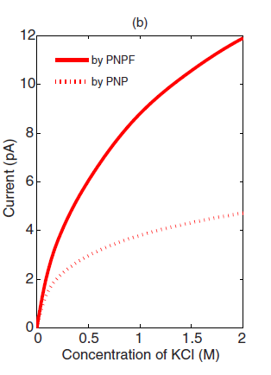
Steric Effect is Large in (crowded) Gramicidin
PNPF vs PNP
Water Occupancy
Current
vs Voltage
K⁺ Occupancy

Slide 37
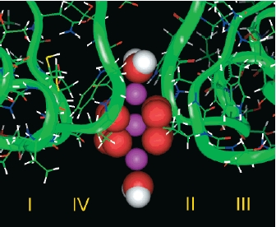
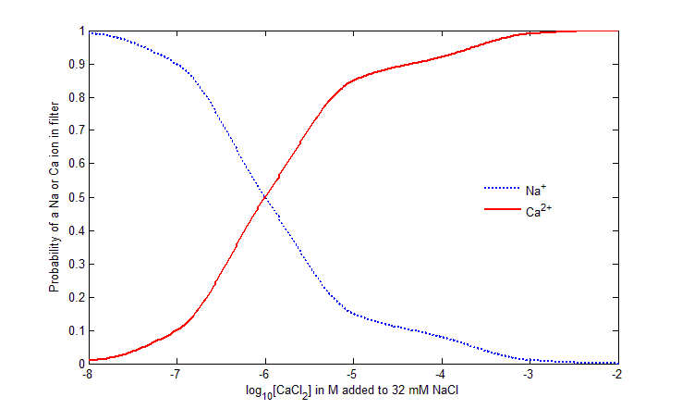
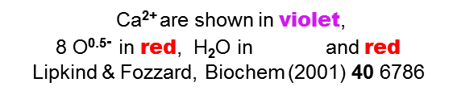
Cardiac Calcium Channel Ca_{V}.n
_{Lipkind-Fozzard Model}
_{Binding Curve}
Liu & Eisenberg J Chem Phys 141(22): 22D532

Slide 38
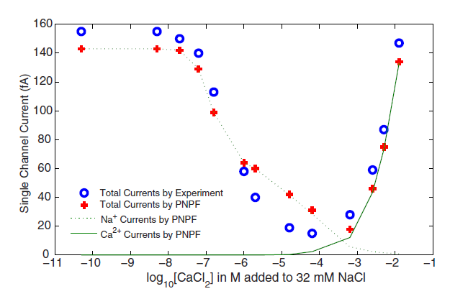


Cardiac Calcium Channel Ca_{V}1.n
Experimental Signature Anomalous* Mole Fraction
Non-equilibrium
Na Channel
Ca Channel
*Anomalous because CALCIUM CHANNEL IS A SODIUM CHANNEL at [CaCl₂] ≅ 10^{-3.4}
Ca²⁺ is conducted for [Ca²⁺] > 10^{-3.4}, but Na⁺ is conducted for [Ca²⁺] <10^{-3.}
Liu & Eisenberg (2015) Physical Review E 92: 012711

Slide 39
Bob Eisenberg DARPA

Slide 40
The End Any Questions?

Slide 41
Extra Slides

Slide 42
Where to start?
Compute all atoms in a device?
Calibrated
all-atom simulations are
Barely Feasible
if they must accurately compute biological function Macroscopic Time & Distance Scales
Macroscopic Electric Fields & Gradients
Power Supplies Power Supply = spatially nonuniform inhomogeneous Dirichlet Boundary Conditions
Flows,
Non-ideal mixtures including Ca²⁺

Slide 43
Scientists
must Grasp and not just reach
Calibrations are necessary
or the Device does not Work
Poets
hope we will never learn the difference between dreams and realities
“Ah, … a man's reach should exceed his grasp, Or what's a heaven for?”
Robert Browning
"Andrea del Sarto", line 98

Slide 44
Details matter in Devices
Uncalibrated Simulations will make Devices that do not work

Slide 45
Devices are built to Implement Equations
in Engineering
Devices evolve to Provide Functions in Biology

Slide 46
In engineering we know the equation and seek to improve the device.
In biology often we have to discover the function, and how molecules perform the function.

Slide 47
Thermodynamics,
Statistical Mechanics,
Molecular Dynamics are UNSUITED for DEVICES
Thermodynamics, Statistical Mechanics, Molecular Dynamics have
No inputs, outputs, flows, or power supplies Power supply = spatially nonuniform inhomogeneous Dirichlet conditions
Analysis of Devices must be
NONEQUILIBRIUM with spatially
non-uniform BOUNDARY CONDITIONS

